Slide 1
CHB-MIT
Overview of Dataset

Slide 2
Data
24 cases from 23 pediatric patients (one patient had a second recording 1.5 years after the first recording [chb01, chb24])
Each case contains roughly 9-42 continuous .edf recordings and EEG signals were sampled at 256 Hz
In most cases each .edf recordings contain exactly one hour of digitized EEG signals (921.600 samples)
Most recordings contain 23 channels resulting in a matrix of typically 23 x 921.600 samples
The montage of the EEG recordings is bipolar and the dataset uses the 10-20-system for electrode annotations

Slide 3
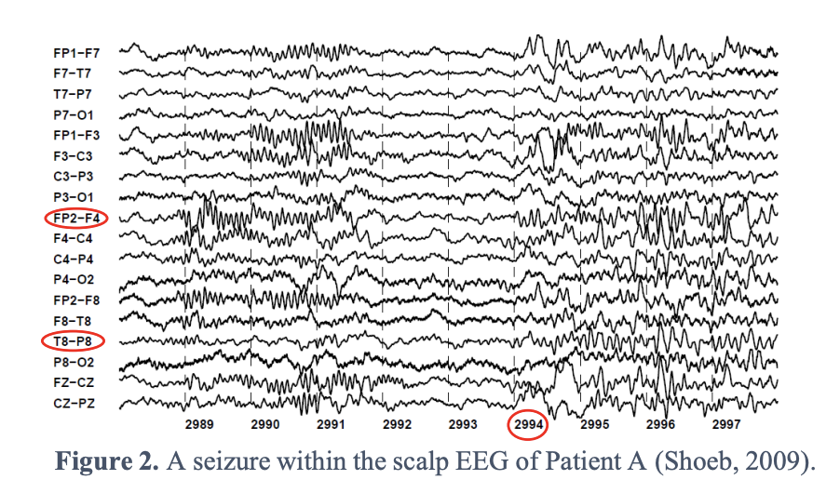
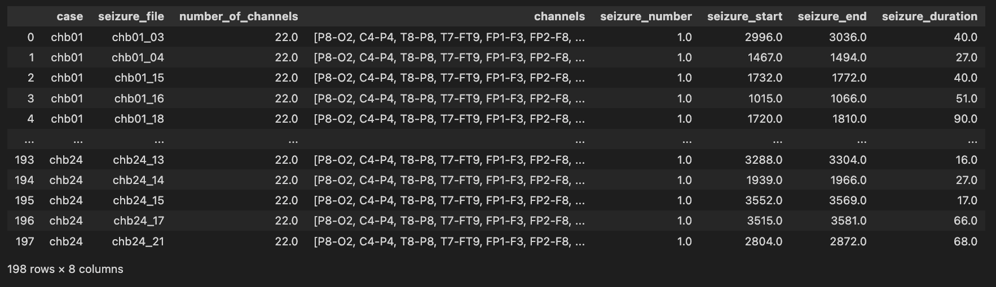
Seizures
198 clinical seizures annotated by experts
Annotations include seizure start and end time
Seizure duration varies from roughly 5-120 seconds (chb11_99: 752 s)
Some .edf recordings contain more than one seizure

Slide 4
